Slide 1

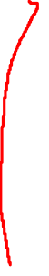
Variables Selection – Direction Search
Here we only give results from forward direction search with BIC:
BODYFAT ~ ABDOMEN + WEIGHT + WRIST + FOREARM BIC=717.64
BODYFAT ~ LogABDOMEN + LogWEIGHT + LogWRIST BIC=714.86
BODYFAT ~ sqABDOMEN + sqWEIGHT + sqTHIGH BIC=725.31
BODYFAT ~ LogABDOMEN + WEIGHT + WRIST BIC=708.82
BIC will give simpler models than AIC.
ABDOMEN and its transformation is also the most important variable, followed by WEIGHT and WRIST.

Slide 2
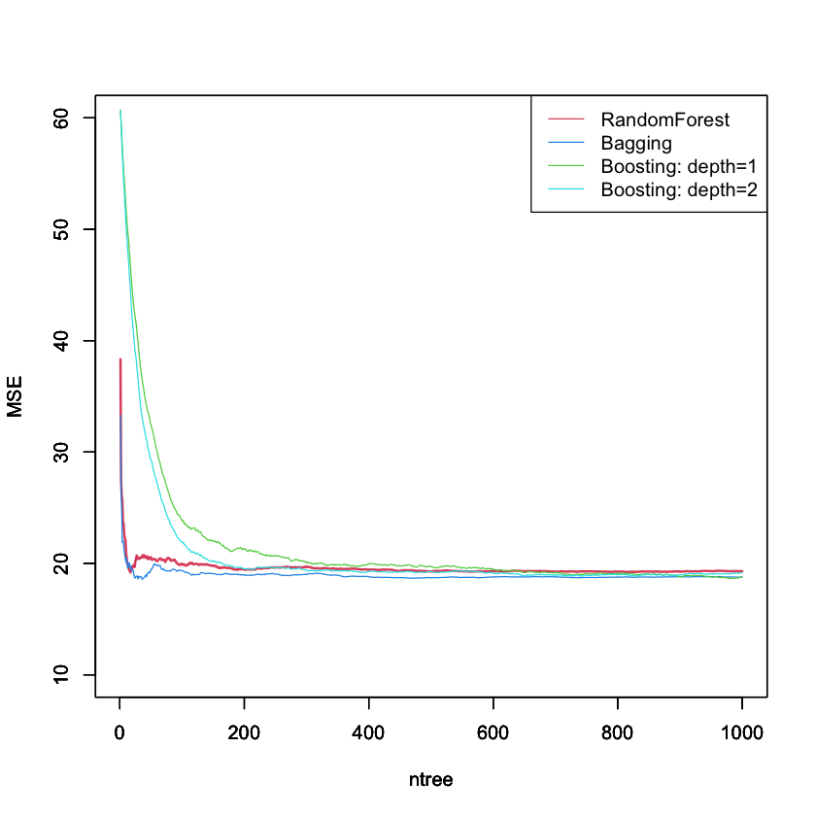
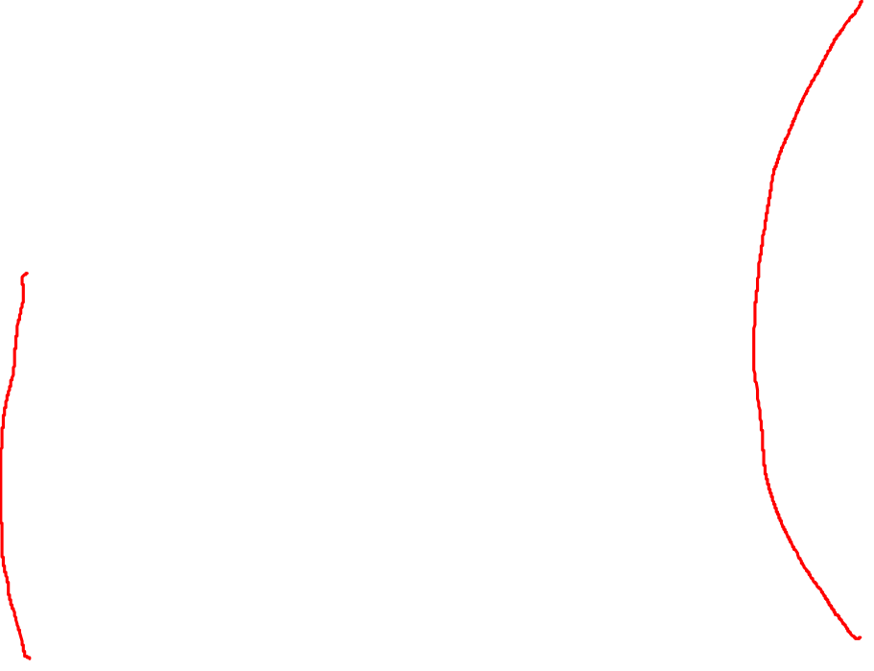
Variables Selection – Tree regression
We choose Bagging and Boosting: depth 2
Here is first 6 important variables:
Important Variables | Bagging | Boosting: depth=2
1 | ABDOMEN | ABDOMEN
2 | HEIGHT | ADIPOSITY
3 | WRIST | HEIGHT
4 | NECK | AGE
5 | WEIGHT | WRIST
6 | ADIPOSITY | BICEPS

Slide 3
Variables Selection – Summary
19 alternative models:
1 BODYFAT~ABDOMEN+HEIGHT+WRIST
2 BODYFAT~ABDOMEN+ADIPOSITY+HEIGHT
3 BODYFAT~ABDOMEN+WEIGHT+WRIST
4 BODYFAT~ABDOMEN+WEIGHT
5 BODYFAT~ABDOMEN
6 BODYFAT~LogABDOMEN+LogHEIGHT+LogWRIST
7 BODYFAT~LogABDOMEN+LogWEIGHT
8 BODYFAT~LogABDOMEN
9 BODYFAT~sqABDOMEN+sqWEIGHT+sqTHIGH
10 BODYFAT~sqABDOMEN+sqWEIGHT
11 BODYFAT~sqABDOMEN
12 BODYFAT~sqWRIST+sqWEIGHT+ABDOMEN
13 BODYFAT~ABDOMEN+sqWEIGHT
14 BODYFAT~ABDOMEN+WEIGHT+WRIST+FOREARM
15 BODYFAT~LogABDOMEN+LogWEIGHT+LogWRIST
16 BODYFAT~LogABDOMEN+WEIGHT+WRIST
17 BODYFAT~LogHEIGHT+LogNECK+LogABDOMEN+LogWRIST
18 BODYFAT~sqWEIGHT+sqABDOMEN+sqFOREARM+sqWRIST
19 BODYFAT~ABDOMEN+THIGH+WRIST+LogAGE+LogTHIGH

Slide 4
Model Selection
We use 30 - repeated with 10 - fold cross validation. The root mean squared error and R-squared: Part of results
ID | Model | Root Mean Squared Error | R-squared
17 | BODYFAT~LogHEIGHT+LogNECK+LogABDOMEN+LogWRIST | 3.976405 | 0.7392734
12 | BODYFAT~sqWRIST+sqWEIGHT+ABDOMEN | 3.937780 | 0.7384296
6 | BODYFAT~LogABDOMEN+LogHEIGHT+LogWRIST | 4.003707 | 0.7335260
3 | BODYFAT~ABDOMEN+WEIGHT+WRIST | 4.059024 | 0.7270816
4 | BODYFAT~ABDOMEN+WEIGHT | 4.110360 | 0.7245327
1 | BODYFAT~ABDOMEN+HEIGHT+WRIST | 4.139776 | 0.7241520
18 | BODYFAT~sqWEIGHT+sqABDOMEN+sqFOREARM+sqWRIST | 4.109423 | 0.7219854
10 | BODYFAT~sqABDOMEN+sqWEIGHT | 4.174410 | 0.7149131
2 | BODYFAT~ABDOMEN+ADIPOSITY+HEIGHT | 4.183036 | 0.7144738
11 | BODYFAT~sqABDOMEN | 4.690806 | 0.6615653

Slide 5
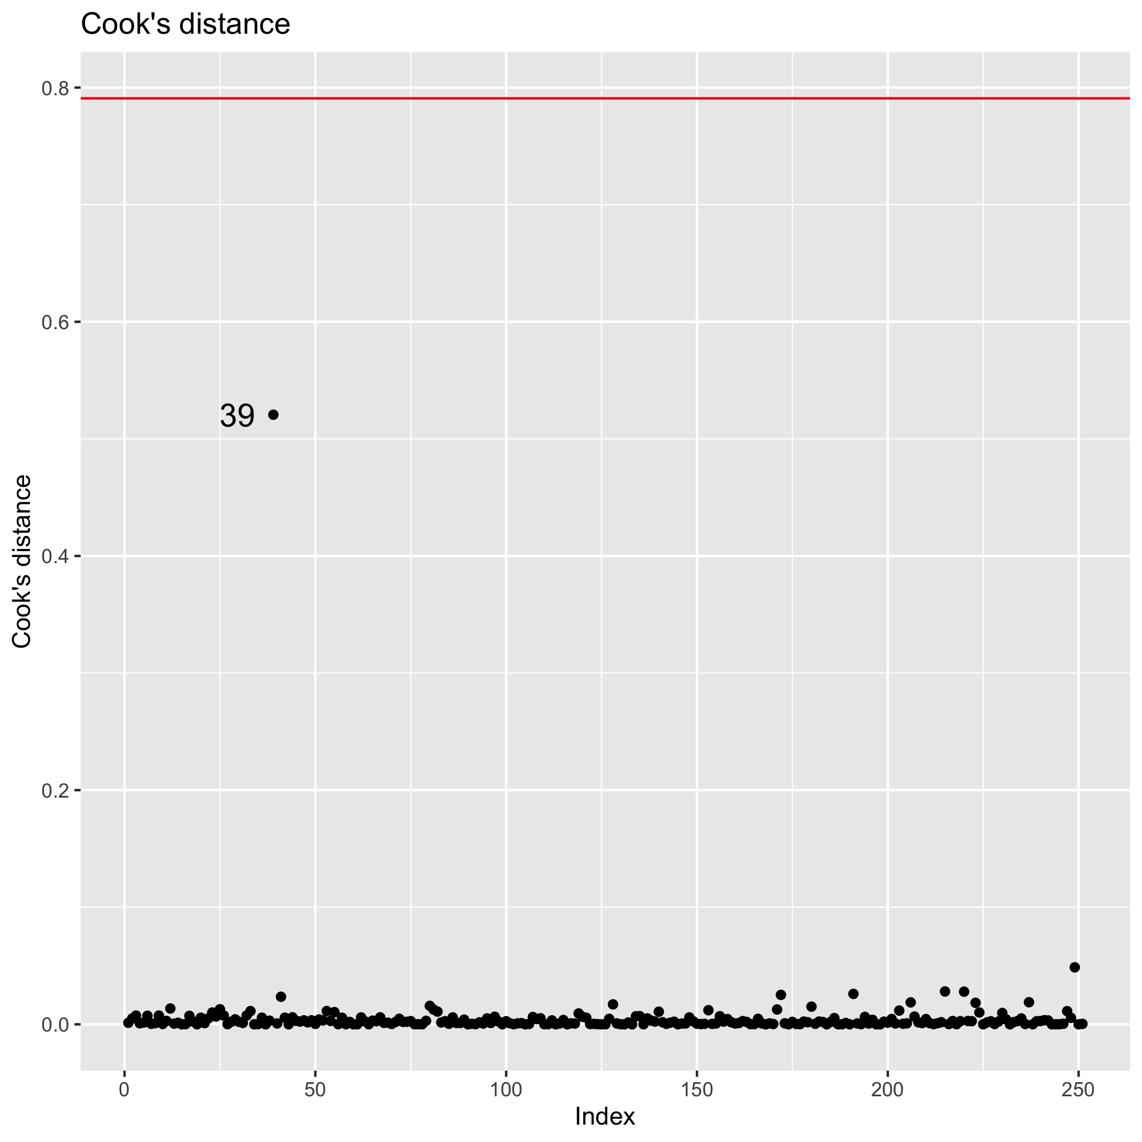
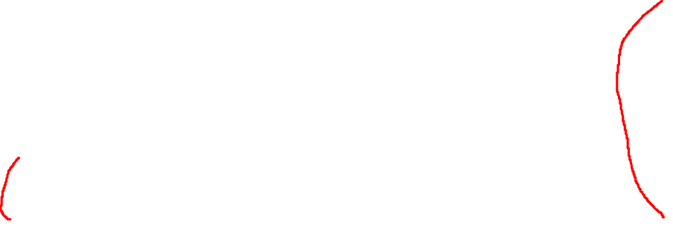
Model Diagnosis and Summary
We choose ABDOMEN, WEIGHT as our predictors.
Final model without influential observation ID39 in Cook’s Distance of initial model:
BODYFAT(%)=0.899 ABDOMEN-0.123 WEIGHT-42.27.
Rule of thumb: BODYFAT(%)=abdomen circumference(cm)*0.899 minus weight(lbs)*0.123 minus 42.27.
Adjusted R squared is 0.72.
Residual standard error is 4.04.
All variables are significant.
No serious multicollinearity, mean VIF=4.0.
Example: Man with 154 lbs WEIGHT and 85 cm ABDOMEN, his BODYFAT will be 15(%).
Coefficients | Estimate | Std Error | P-value | 95% CI Lwr | 95% CI Upr
Intercept | -42.27 | 2.446 | < 2e-16 | -47.087 | -37.450
ABDOMEN | 0.899 | 0.052 | < 2e-16 | 0.798 | 1.001
WEIGHT | -0.123 | 0.019 | 1.37e-09 | -0.161 | -0.084

Slide 6
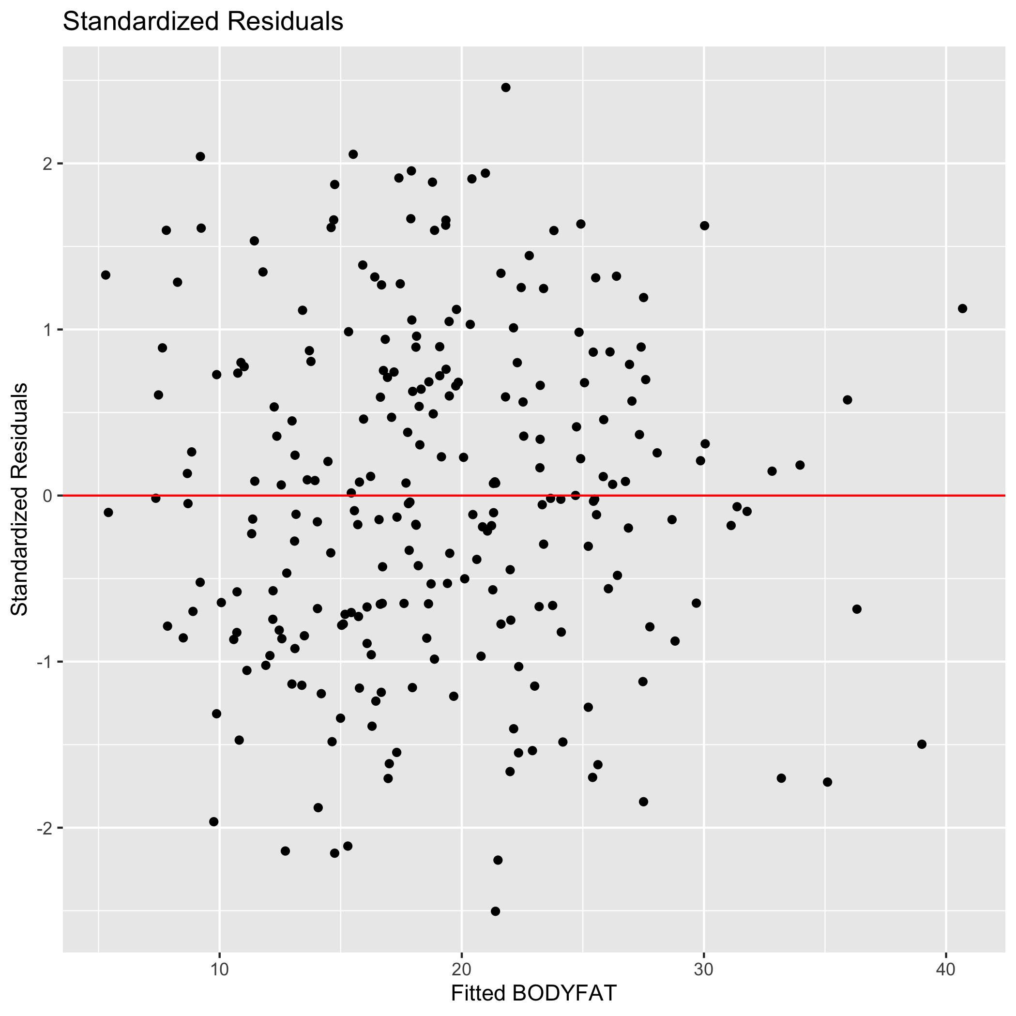
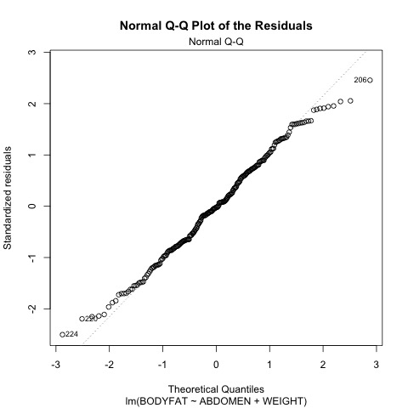
Model Diagnosis – Standardized Residuals, QQ plots for Residuals

Slide 7
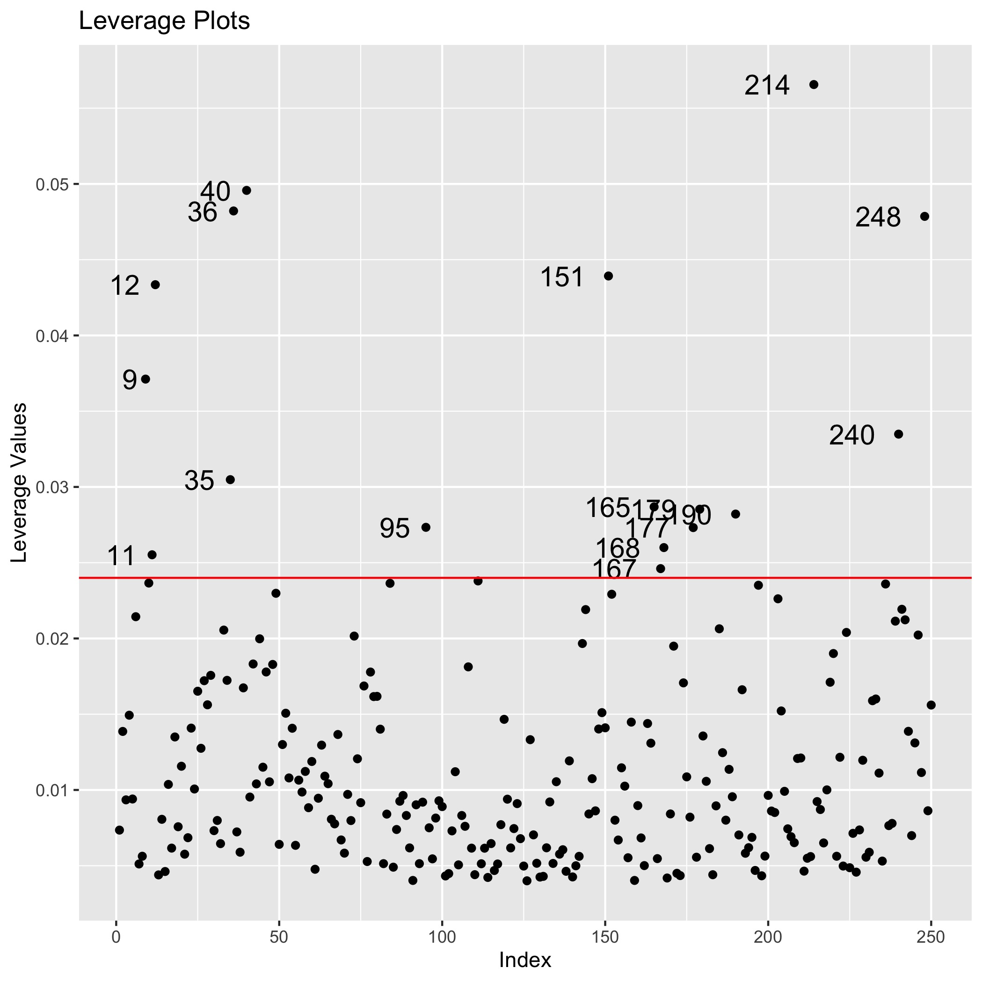
Model Diagnosis – Leverage Plots
The leverage is diagonal elements from 𝐻=𝑋(𝑋′𝑋)⁻¹𝑋′
There is some outliers in Leverage plots, which show the outliers when we take ABDOMEN and WEIGHT as predictors.

